Slide 1





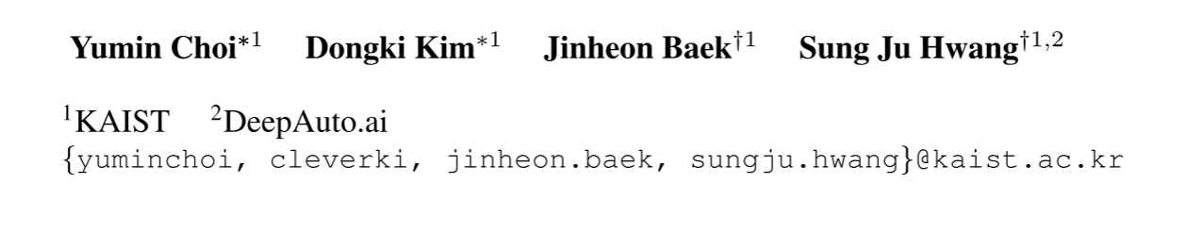



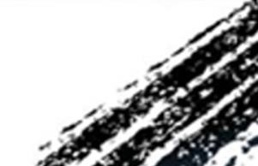

ATAI
Advanced Techniqueof Artificial Intelligence
ATAI
ChongqingUniversity _{AdvancedTechniqueof}
of Technology Artificial Intelligence
Chongqing University of
Technology
Chongqing University ^{ATAI}
_{of Technology} Advanced Techniqueof
Artificial Intelligence
Chongqing University of Technology
Chongqing University of Technology
Multimodal Prompt Optimization：Why Not Leverage Multiple Modalities for MLLMs
Code: https://github.com/Dozi01/MPO
—— ICLR_2026
Reported by HongLiang Nie
1

Slide 2

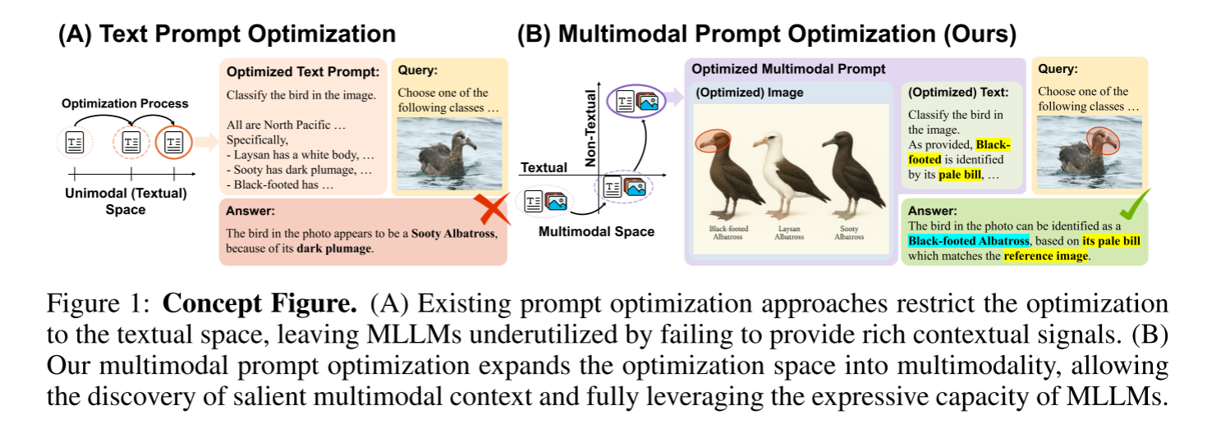
ATAI
AdvancedTechniqueof
Artificial Intelligence
ATAI
ChongqingUniversity _{AdvancedTechniqueof}
of Technology Artificial Intelligence
ChongqingUniversity of Technology
Motivation
existing prompt optimization methods remain restricted to the textual modality and overlook the richer expressive capacity afforded by multimodal inputs (that text alone cannot capture). For instance, as illustrated in Figure 1,describing the distinct characteristics of a specific bird may require long and potentially ambiguous text, while a single image can convey the same information far more directly.

Slide 3

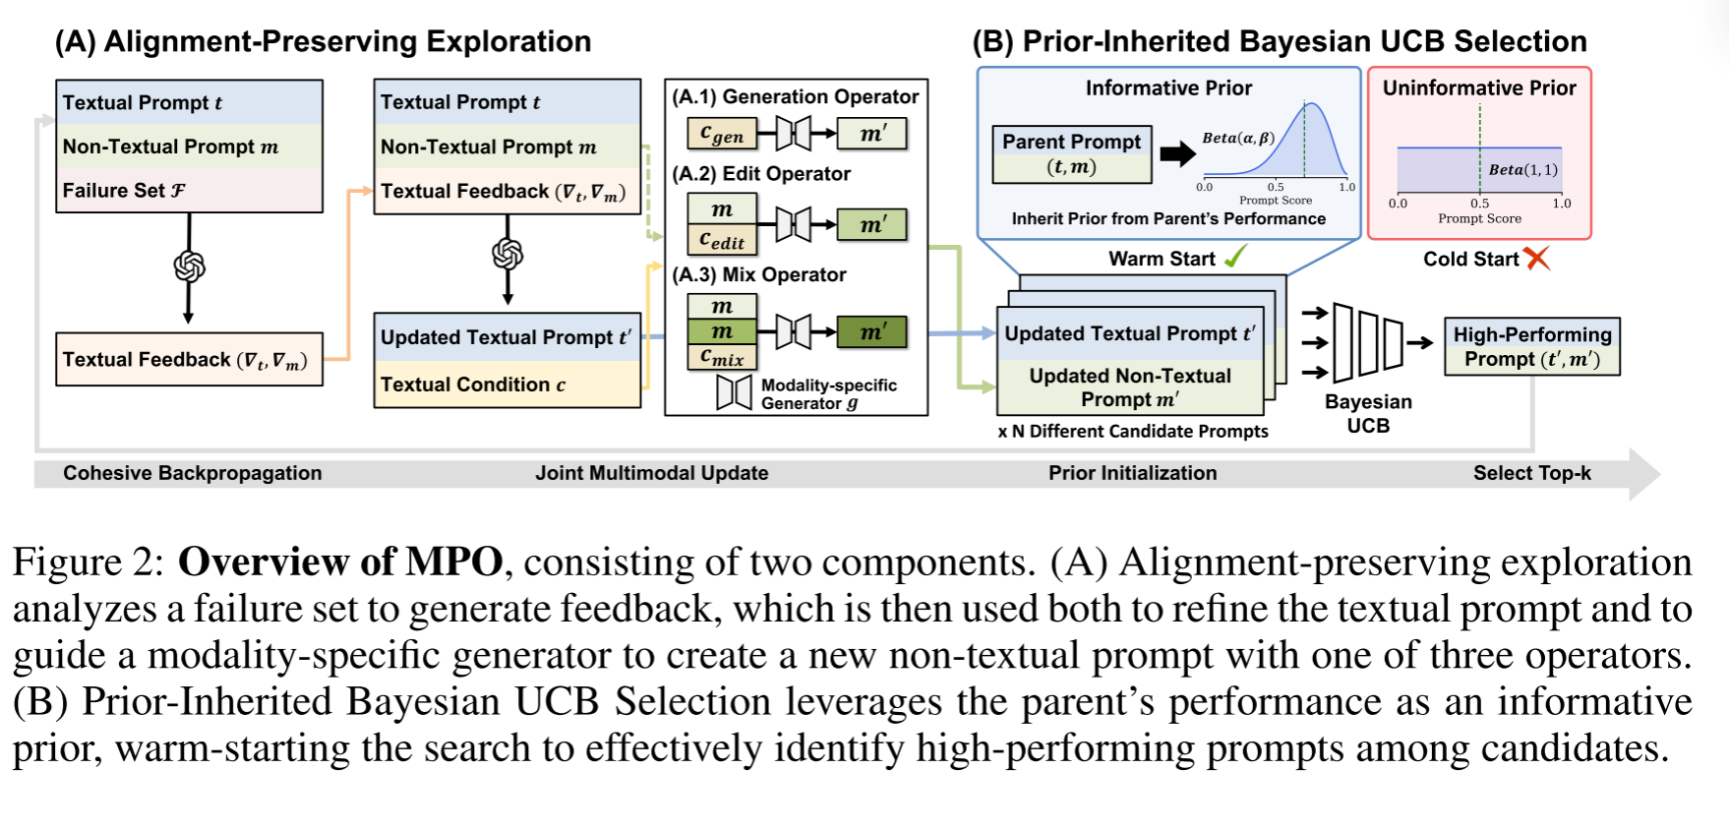
ChongqingUniversity of Technology
ATAI
AdvancedTechniqueof
Artificial Intelligence
ATAI
ChongqingUniversity _{AdvancedTechniqueof}
of Technology Artificial Intelligence
Overview

Slide 4
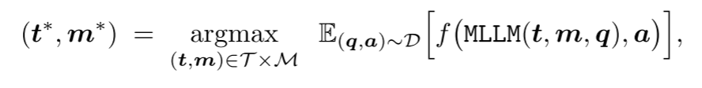
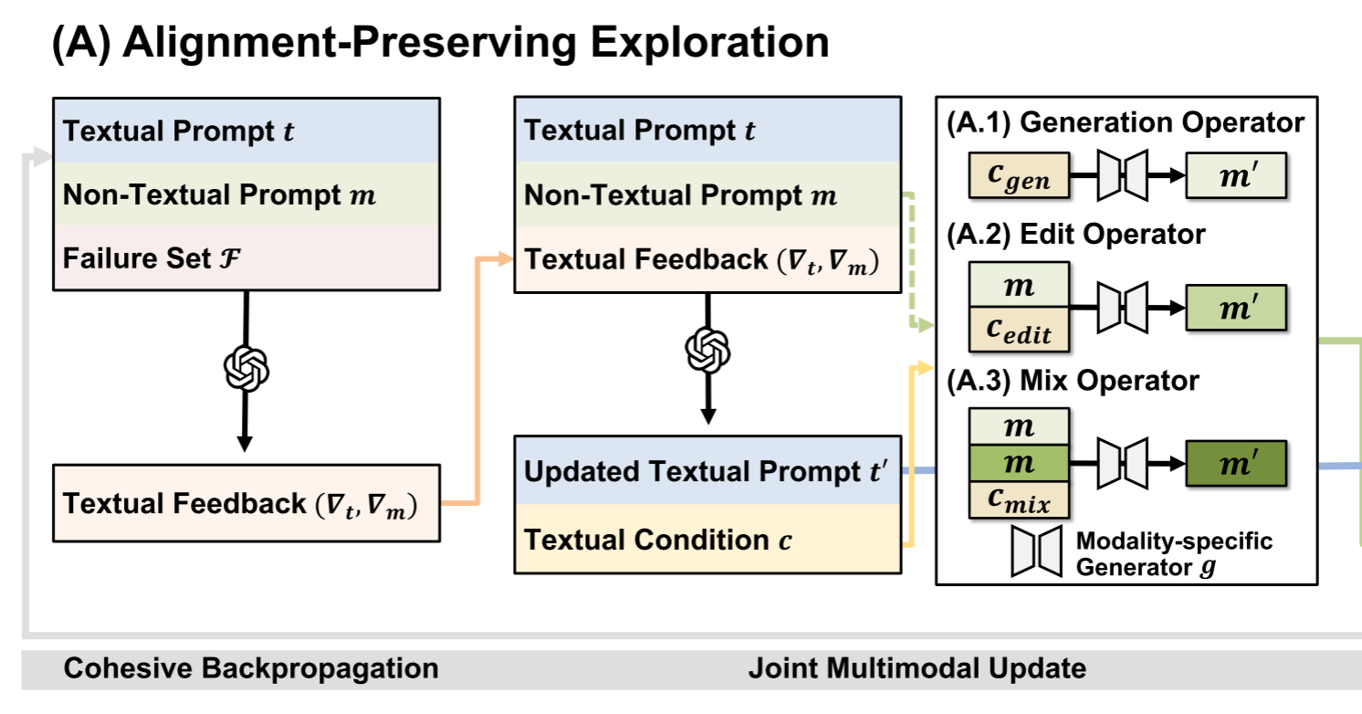
ChongqingUniversity of Technology
ATAI
AdvancedTechniqueof
Artificial Intelligence
ATAI
ChongqingUniversity _{AdvancedTechniqueof}
of Technology Artificial Intelligence
Method

Slide 5
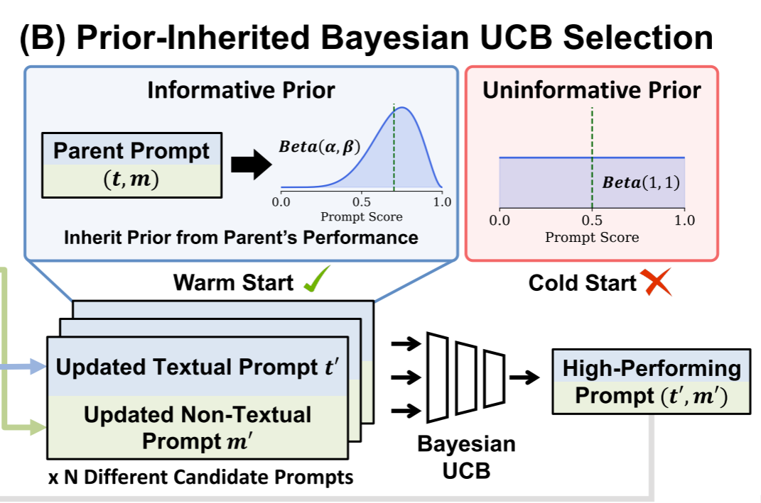
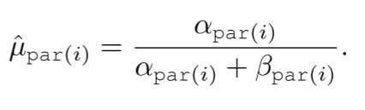
ChongqingUniversity of Technology
ATAI
AdvancedTechniqueof
Artificial Intelligence
ATAI
ChongqingUniversity _{AdvancedTechniqueof}
of Technology Artificial Intelligence
Method

Slide 6

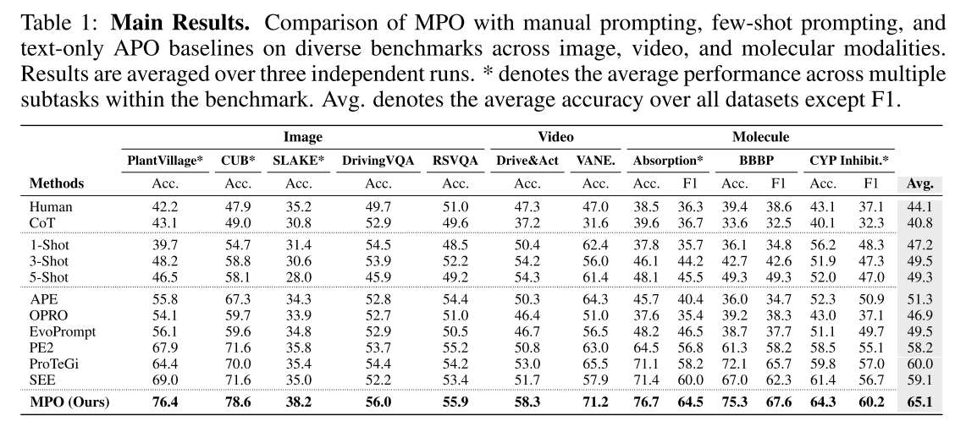
ATAI
AdvancedTechniqueof
Artificial Intelligence
ATAI
ChongqingUniversity _{AdvancedTechniqueof}
of Technology Artificial Intelligence
ChongqingUniversity of Technology
Experiments

Slide 7
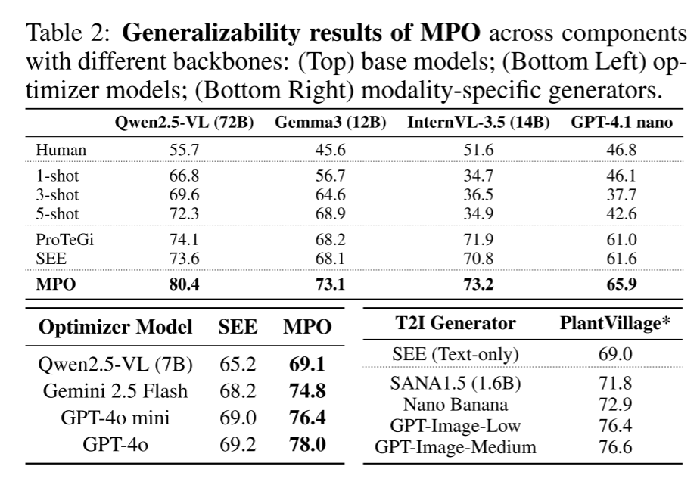
ATAI
AdvancedTechniqueof
Artificial Intelligence
ATAI
ChongqingUniversity _{AdvancedTechniqueof}
of Technology Artificial Intelligence
ChongqingUniversity of Technology
Experiments

Slide 8
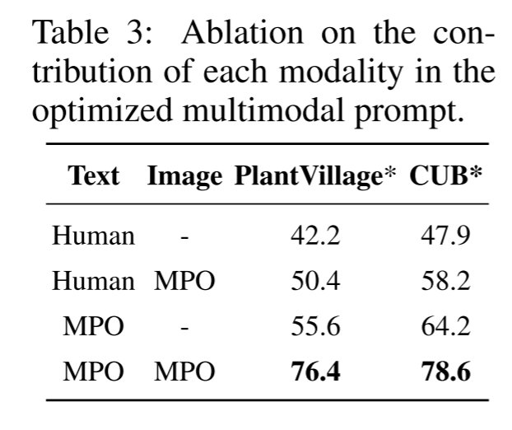
ATAI
AdvancedTechniqueof
Artificial Intelligence
ATAI
ChongqingUniversity _{AdvancedTechniqueof}
of Technology Artificial Intelligence
ChongqingUniversity of Technology
Experiments

Slide 9
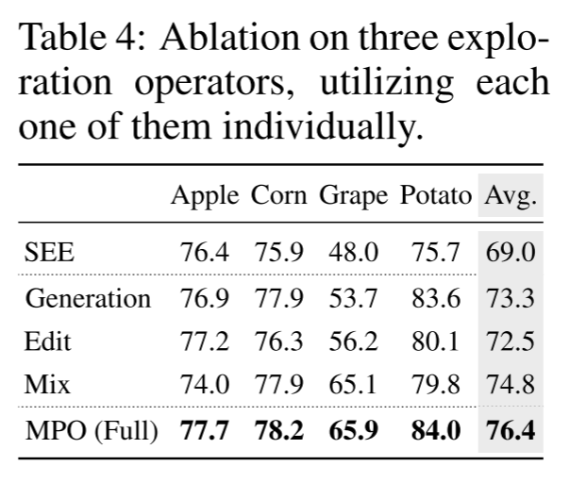
ATAI
AdvancedTechniqueof
Artificial Intelligence
ATAI
ChongqingUniversity _{AdvancedTechniqueof}
of Technology Artificial Intelligence
ChongqingUniversity of Technology
Experiments

Slide 10
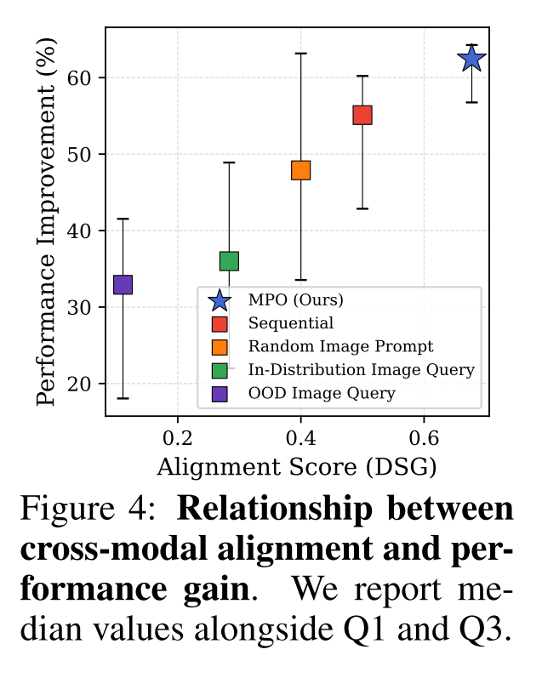
ATAI
AdvancedTechniqueof
Artificial Intelligence
ATAI
ChongqingUniversity _{AdvancedTechniqueof}
of Technology Artificial Intelligence
ChongqingUniversity of Technology
Experiments

Slide 11
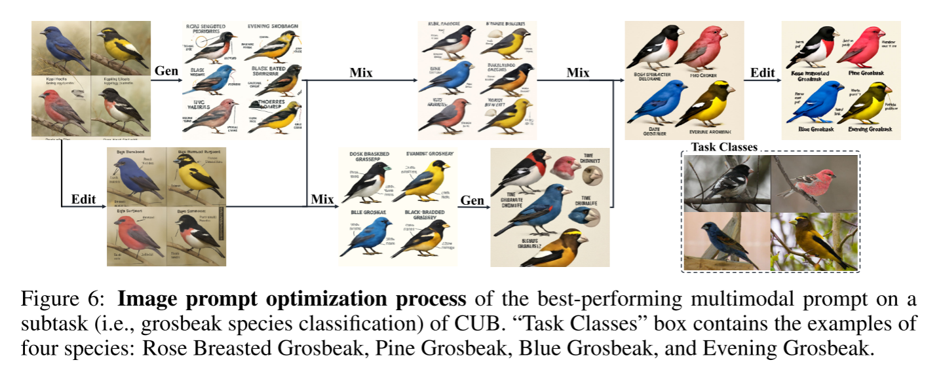
ATAI
AdvancedTechniqueof
Artificial Intelligence
ATAI
ChongqingUniversity _{AdvancedTechniqueof}
of Technology Artificial Intelligence
ChongqingUniversity of Technology
Experiments

Slide 12
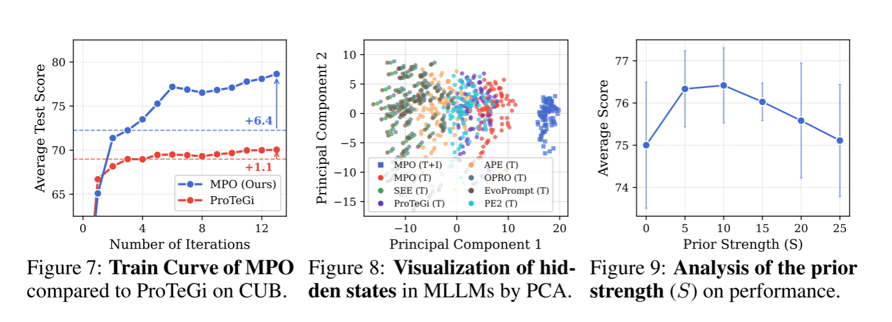
ATAI
AdvancedTechniqueof
Artificial Intelligence
ATAI
ChongqingUniversity _{AdvancedTechniqueof}
of Technology Artificial Intelligence
ChongqingUniversity of Technology
Experiments

Slide 13


ChongqingUniversity of Technology
ATAI
AdvancedTechniqueof
Artificial Intelligence
ATAI
ChongqingUniversity _{AdvancedTechniqueof}
of Technology Artificial Intelligence
Thanks!

